Slide 1
Organach
PAKISTANI
PINK SALT
100% NATURAL ROCK SALT
www.organach.com.pk

Slide 2
“AIM OF ORGANACH”
With our own salt mines and state-of-the-art production units, we ensure unmatched quality, consistent quantity, competitive pricing, and on-time delivery, backed by full control over raw material availability. We offer customized packaging for pink salt in various sizes and formats, jars, pouches, glass bottles, and bulk bags - tailored to retail, wholesale, or private label needs. All packaging is supported with custom branding and required certifications for any region, ensuring compliance and appeal in both local and international markets.
Organach

Slide 3
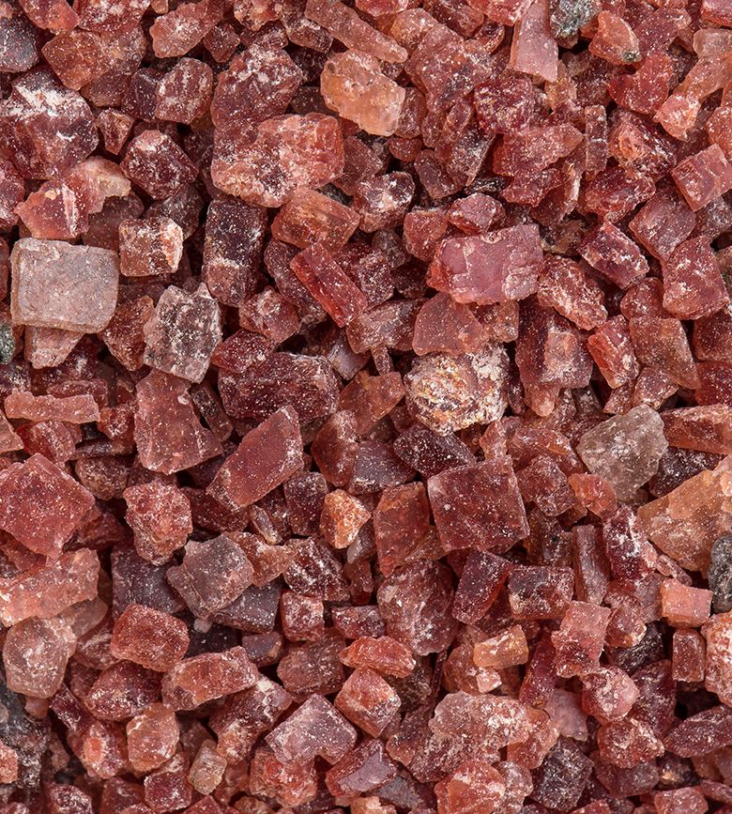
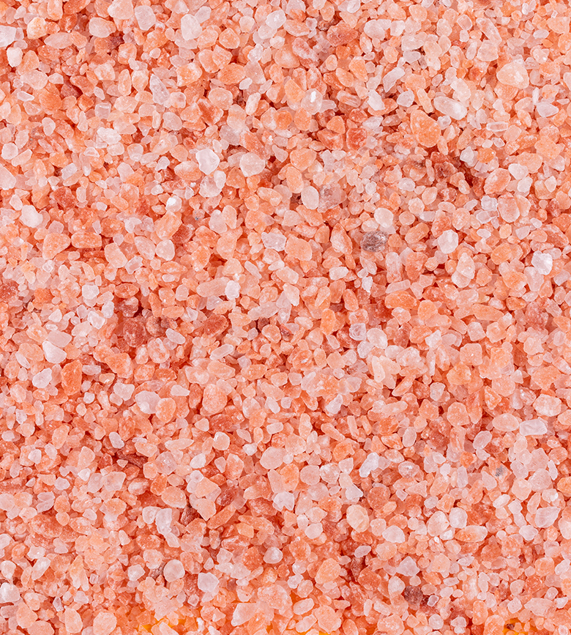
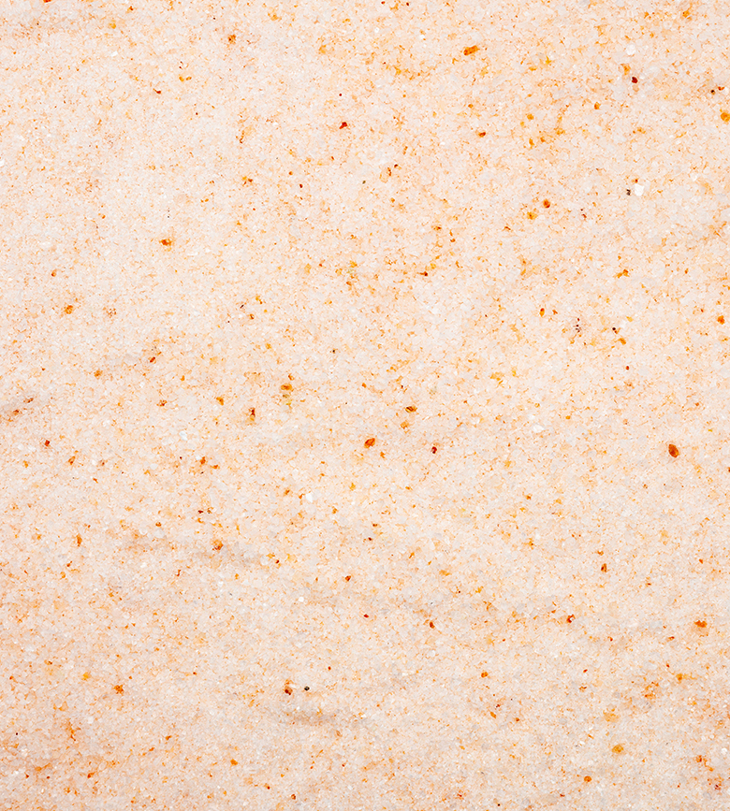
BASIC FACTS
White Salt: White salt (commonly known as table salt or refined salt) is primarily sodium chloride (NaCl).
Pink Salt (Pink Salt): Pink salt is also mostly sodium chloride (NaCl) (up to 98%), Iron oxide (gives color), magnesium, etc. It contains trace minerals like magnesium, potassium, calcium, and iron, which give it the pink color.
Dark Pink Salt: Sodium Chloride (NaCL), The darker pink color is due to a higher concentration of iron oxide which is a natural form of iron found in rocks and minerals.
Organach

Slide 4
Organach

Slide 5
Organach
BUSINESS INSIDER

Slide 6
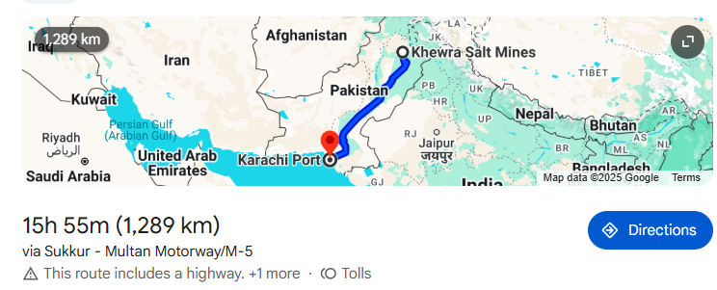
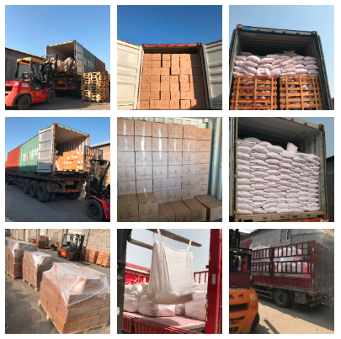
TRANSPORTATION TOWARDS KHI DETAILS FROM KHEORA KM AND OTHER DETAILS
Distance From Our Khewra & Kala Bagh Mines to Karachi Port
Distance: Approx. 1,289 to 1600 km by road
Travel Time: Around 20–24 hours
Processing Units:
Primary Unit: Located near Khewra Mines (for bulk processing & initial packaging) at nearby unit
Secondary Unit: Near Lahore (for value-added packaging & exports)
Logistics Workflow:
Salt extracted from Khewra Mines
Transported via heavy-duty trucks to Karachi Port
Alternate route via Lahore unit (for customized orders or export-ready packaging)
Key Benefits:
Efficient & direct logistics from mine to port
Flexibility with two processing points
Timely delivery & secure transportation
Organach

Slide 7
TYPES & CATEGORIES OF SALT
EDIBLE SALT
ANIMAL FEED SALT
CRAFT WORK & CREATIONS
WELLNESS & SPA SALT
INDUSTRIAL SALT
PHARMACEUTICAL & MEDICAL USE
Organach

Slide 8
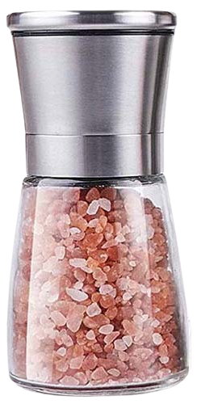
EDIBLE SALT
•Table Salt
•Fine Salt
•Coarse Salt
•Iodized / Non-Iodized Salt
•Pink Salt with Black pepper (Edible)
TYPES & CATEGORIES OF SALT
Organach

Slide 9
ANIMAL FEED SALT
•Lick Salt (Blocks, Bricks, Customized)
•Crushed Salt for Livestock
Organach
TYPES & CATEGORIES OF SALT
Organach

Slide 10
CRAFT WORK & CREATIONS
•Salt Lamps
•Salt Candle Holders
•Salt Tiles
•Salt Slabs
•Salt Bricks (For Rooms, Walls)
TYPES & CATEGORIES OF SALT
Organach

Slide 11
WELLNESS & SPA SALT
BATH SALT
SPA SALT
SALT SCRUBS
HEALING ROOMS
TYPES & CATEGORIES OF SALT
Organach

Slide 12
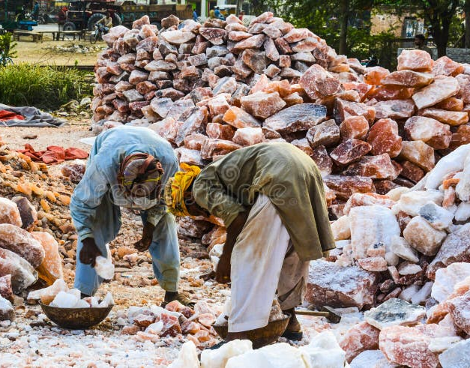
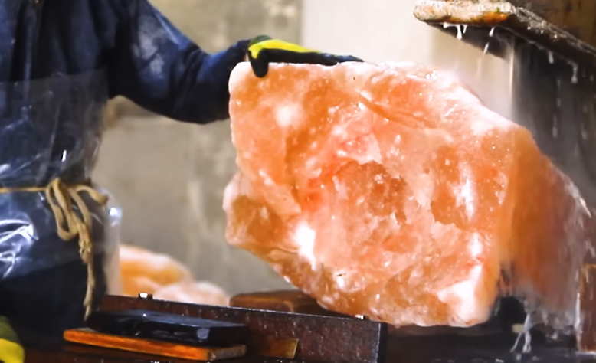
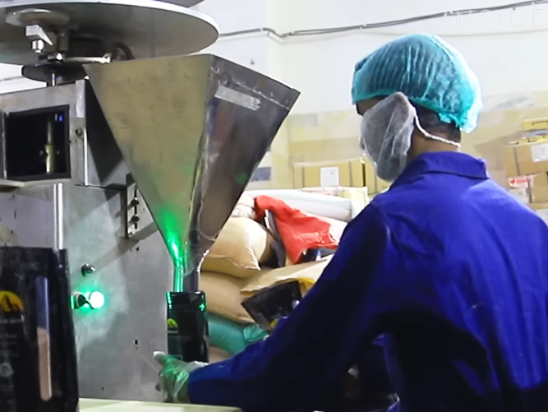
INDUSTRIAL SALT
•DE-ICING SALT
•OIL & GAS DRILLING SALT
TYPES & CATEGORIES OF SALT
Organach

Slide 13
MEDICAL USE & HEALTH BENEFITS
Inhalers (Salt Therapy)
Uses: Treatment for asthma, bronchitis, allergies, and sinusitis.
How: Finely ground salt is used in salt inhalers and salt rooms to clear mucus, reduce inflammation, and improve breathing
Nasal and Sinus Care
Uses: Relief of congestion and sinus infections.
How: Used in neti pots and nasal sprays for daily hygiene and allergy support.
Minerals Supplements
Uses: Source of essential trace minerals like magnesium, potassium, calcium, and iron.
How: Consumed in regulated form for patients with mineral deficiencies.
TYPES & CATEGORIES OF SALT
Organach

Slide 14
CRAFT WORK & CREATIONS
Organach

Slide 15
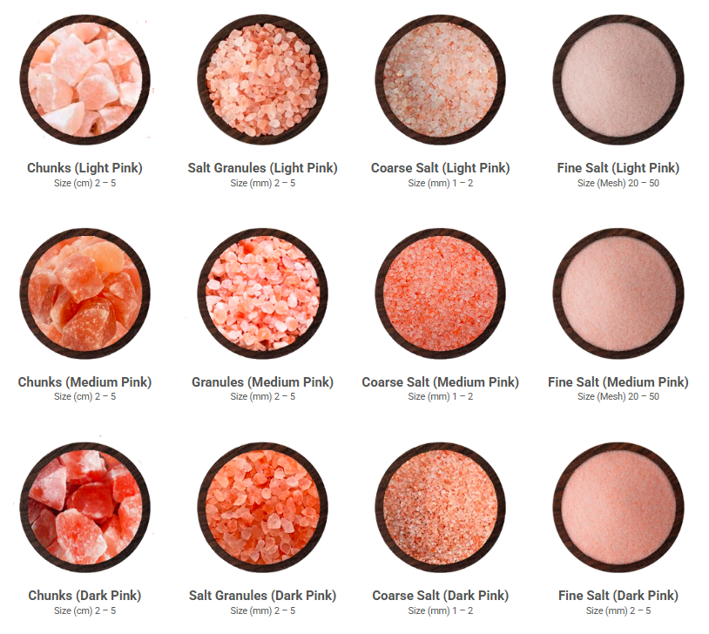
Edible Pink Salt
Organach

Slide 16
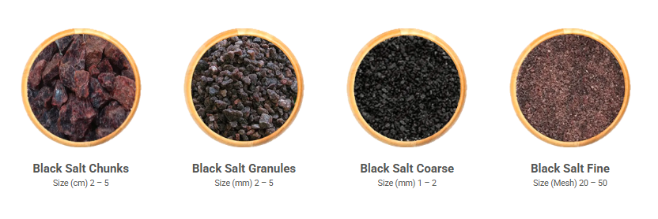
Edible White Salt
Our Edible White Salt is a 100% pure, unrefined rock salt—rich in essential minerals and a healthier alternative to regular table salt.
Edible Black Salt
Black salt, or kala namak, is made by heating natural rock salt with herbs and spices, giving it a black color and unique tangy flavor.

Slide 17
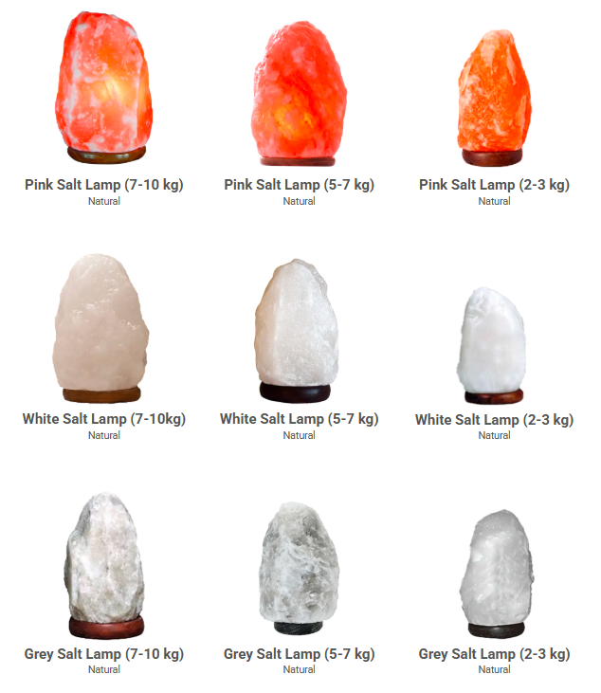
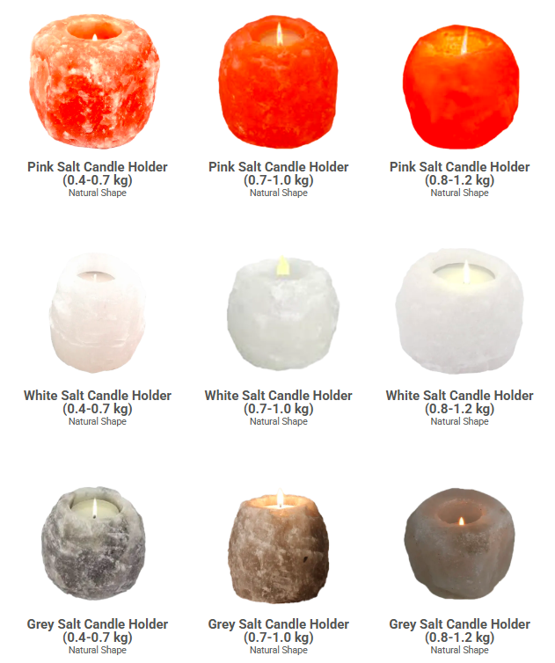
WELNESS
Natural Shape Salt Lamps
Natural Shape Salt Candle Holder

Slide 18
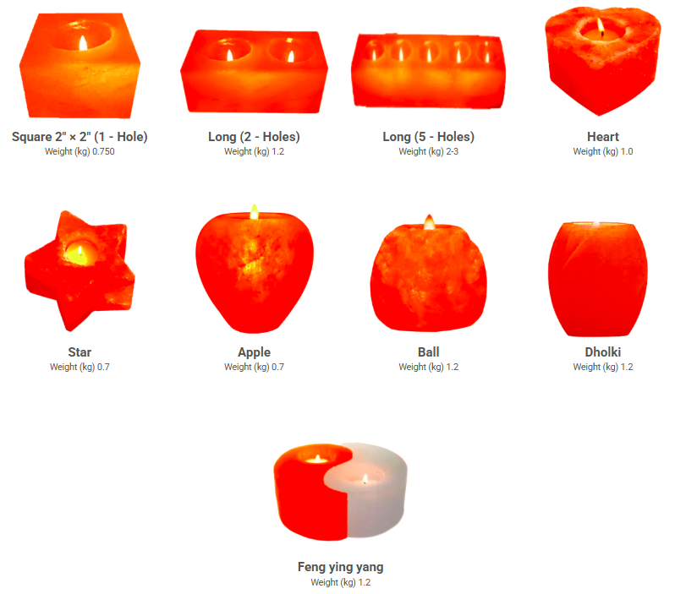
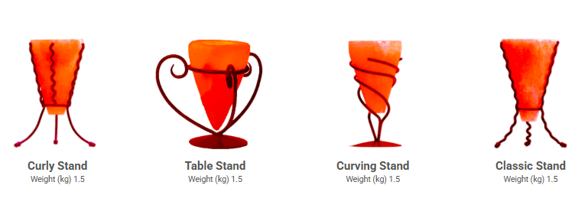
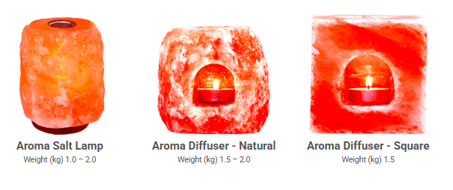
WELNESS
Geometric Shape Candle Holder​
Salt Candle Holder (Cone Shape)
Salt Aroma Diffusers Products
Organach

Slide 19
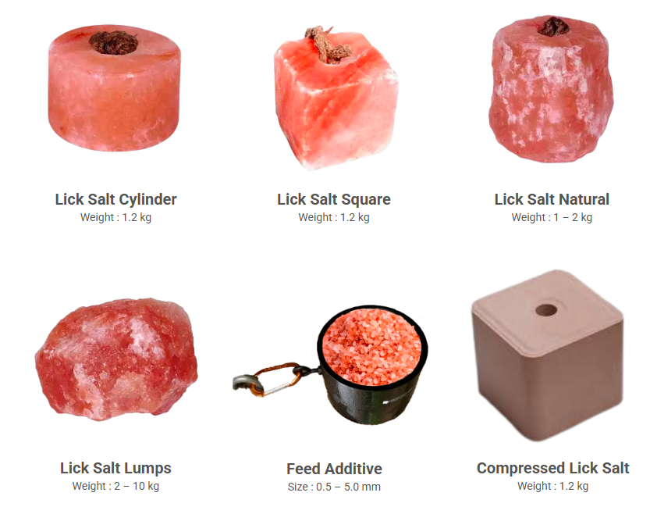
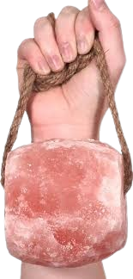
Animal Lick Salt
Our premium pink animal lick salt, made from pure rock salt, is a natural source of essential minerals that support animal health, growth, and strong bones.
Organach

Slide 20
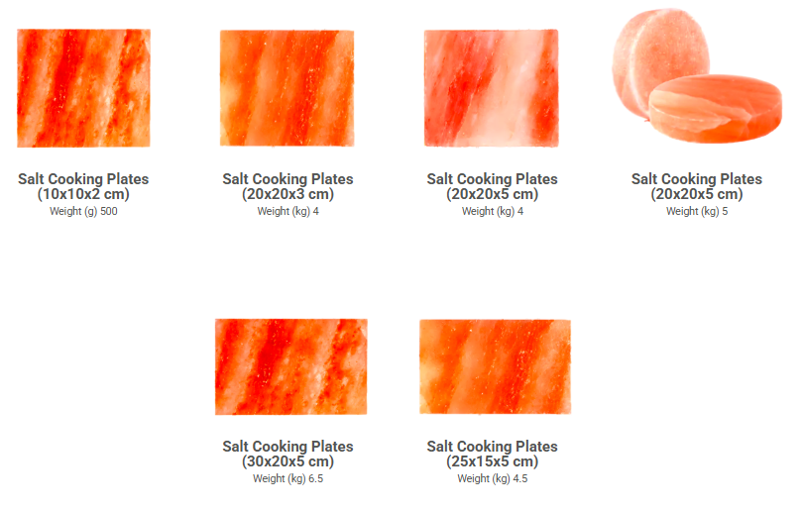
Rock Salt Cooking Plates
Our premium pink salt cooking blocks add a unique flavor and mineral boost to your dishes while enhancing food presentation. Available in various shapes and sizes, they are ideal for bulk supply to importers, wholesalers, and global brands.
Organach

Slide 21
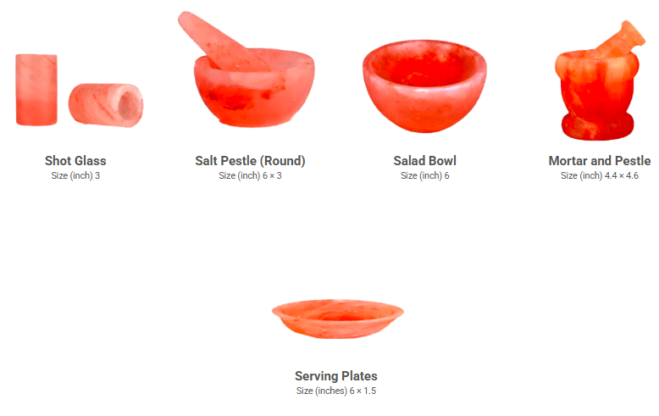
Pink Salt Crockery Products
Our handcrafted pink salt crockery combines elegant presentation with natural functionality, perfect for cooking, serving, or kitchen decor. We offer a wide range including shot glasses, bowls, plates, and mortar & pestles for wholesale supply.
Organach

Slide 22
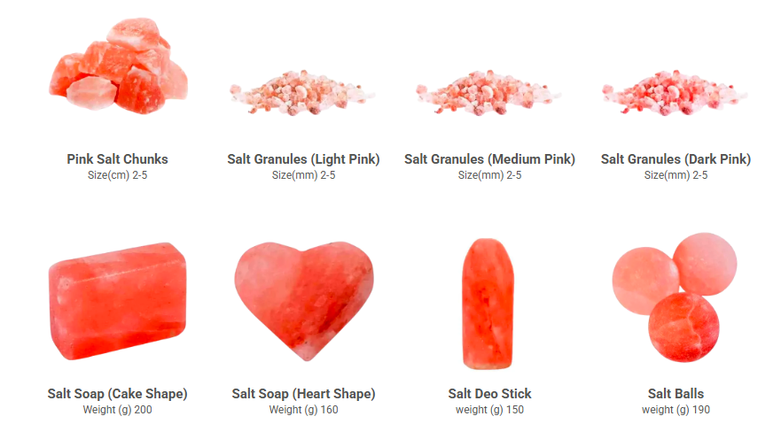
Pink Salt Bath Products
Our premium pink bath salt is rich in natural minerals, offering therapeutic benefits like soothing sore muscles, improving circulation, and promoting healthier skin. Ideal for bulk supply to wellness and personal care brands.

Slide 23
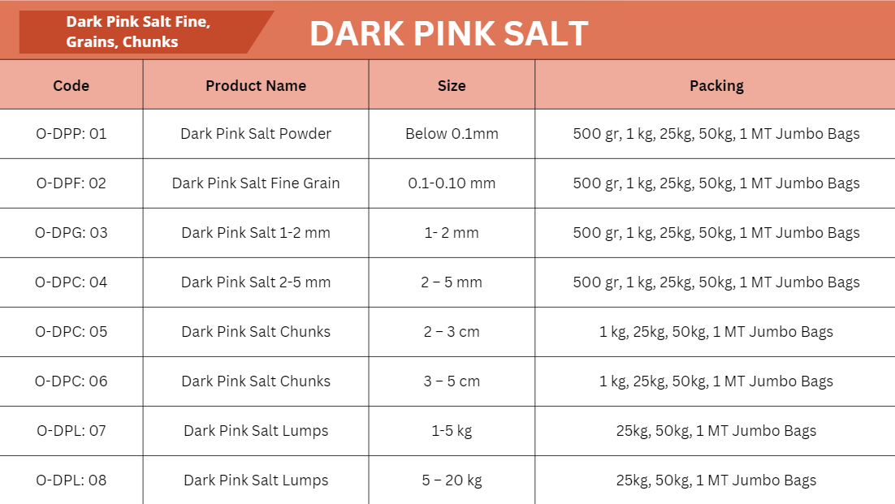
Organach

Slide 24
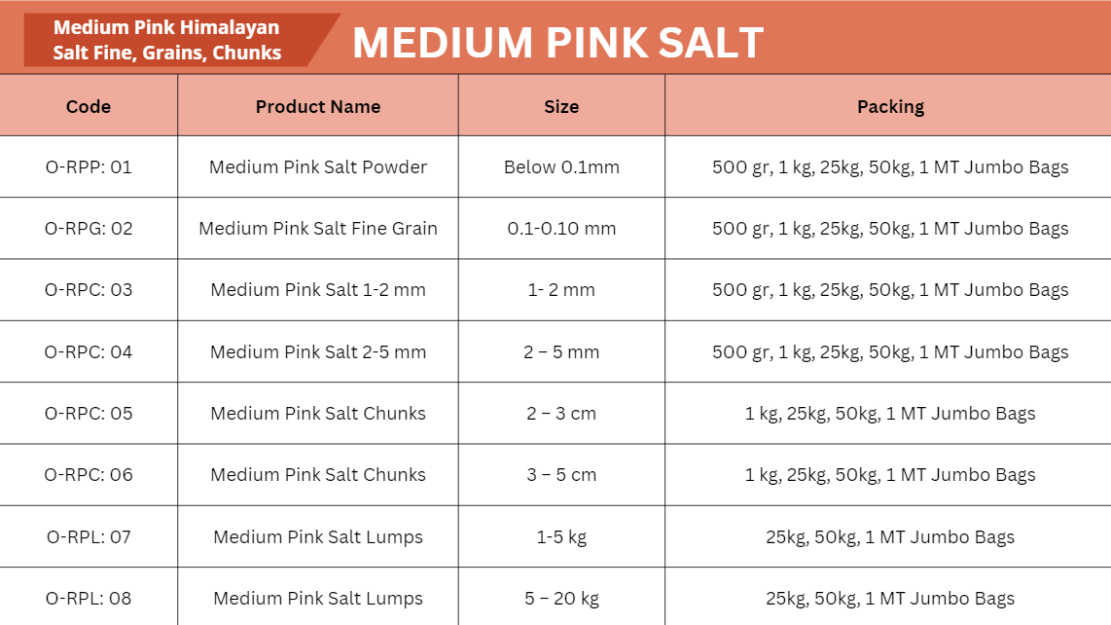
Organach

Slide 25
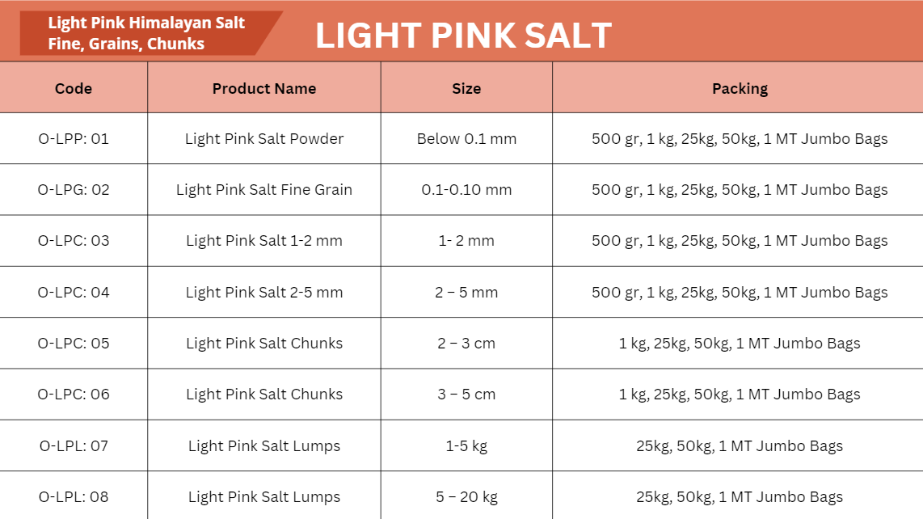
Organach

Slide 26
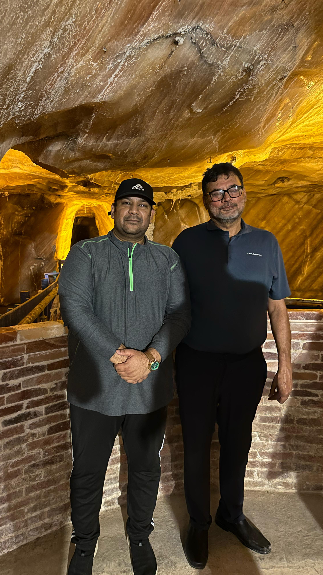
OUR TEAM VISIT @ SALT MINES
Organach

Slide 27
Pricing Methodology & Market Benchmarking
"All pricing will be finalized based on the volume and specifications of confirmed orders. To ensure transparency and fairness, quoted rates will be cross-verified with prevailing market conditions and credible industry benchmarks at the time of execution. This approach ensures that clients receive competitive and justified pricing aligned with current market realities."
Organach

Slide 28
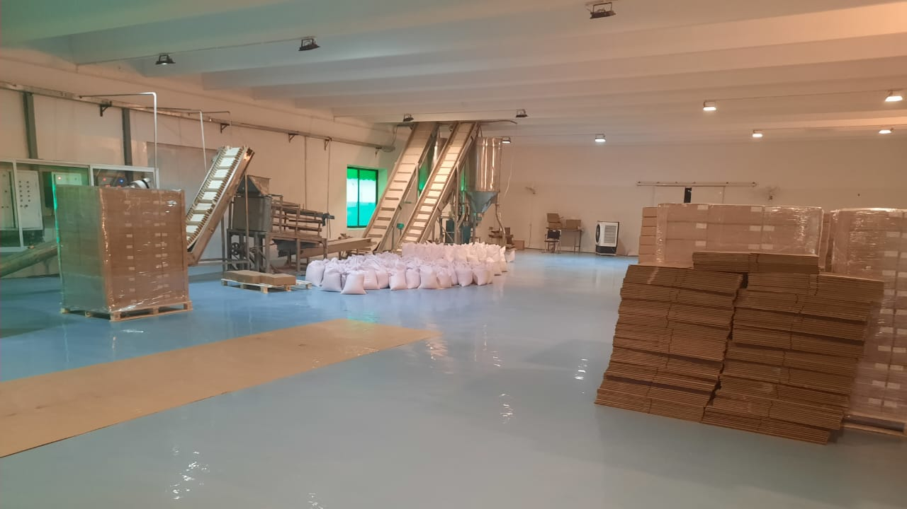
Organach

Slide 29
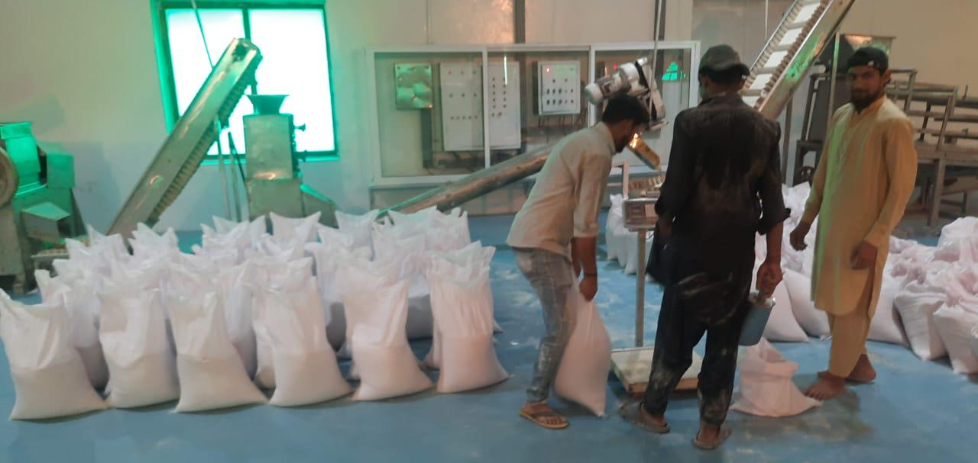
Organach

Slide 30
THANK YOU!
CONTACT US AT:
Pakistan Office Address: 2nd Floor, 147-D BLOCK, Commercial Broadway, Phase 8, DHA, Lahore, Pakistan.
Hotline: +92 3 070 345 345 WhatsApp: +92 3 111 444 708 ,
E-mail: info@organach.com.pk, healthguard.pk@gmail.com
www.organach.com.pk
GROUP OF COMPANIES

